Slide 1


Vision Empower Trust AI Skilling Program
Introducing Artificial Intelligence,
Responsible, Informed, Conscious (RIC) Use of AI
MODULE-1
Vision Empower Trust

Slide 2
Agenda
Item | Details
Audience | Teachers, special educators, resource persons and school leaders working with visually impaired students
Duration | 90 minutes
Mode | Facilitator-led, discussion-based, with one short hands-on or scenario activity
Prerequisites | Basic smartphone/computer familiarity; no prior AI knowledge required
Module purpose | To introduce AI formally, explain how it differs from earlier technologies, clarify AI/ML/Generative AI, show key capabilities, promote Responsible, Informed and Conscious AI Use
Session principle | Teacher judgement remains central. AI is an assistant for access, planning and communication; it is not a replacement for the teacher.

Slide 3
Pre-Assessment
Do you know the difference between Traditional technologies vs AI technologies?
Do you know the difference between supervised and unsupervised learning ?
What is the role of data in making an AI solution useful?
What does human-in-the-loop mean and why is it important?
Can AI make mistakes ?
What is hallucination ?
Does AI have emotions ?
Do you think Responsible, Informed and Conscious use of AI is necessary?

Slide 4
Ice Breaker – Thinking about different technologies
Objective
Recall technologies and the problems they solve.
Reflect on the following:
  What problem did it solve?
  How does it help today?
Key Takeaway
Technology has evolved from the Abacus to AI, making life, learning, and accessibility easier.
Some technologies are not present anymore, they have evolved and other tools have taken their place
Notes:
Help the audience list the technologies : Television, Radio, Washing machine, refrigerator, Trains, Aeroplanes, Electricity, Solar Energy, Wind mills, Abacus, Calculator, telegraph, AI tools , White Cane, computers, smartphones etc.

Slide 5
Ice Breaker – Can you spot the AI ?
Do you use AI ? How ?
Artificial intelligence is used in a number of ways in our daily lives. Can you spot the AI?
  Traffic light changing at fixed intervals
  Face Recognition System
  Washing machine with preset timer
  Voice assistant
  YouTube video recommendations
  Spell check & grammar tools
  Google Maps route suggestions
Some technologies are automation based, but most are are evolving with AI integration
Notes:
I Used?
How AI is Used
Traffic light changing at fixed intervals❌ NoA fixed-time traffic light follows a pre-programmed schedule. It does not learn or make decisions based on traffic conditions. (Adaptive traffic signal systems, however, can use AI.)
Face Recognition System✅ YesAI, especially deep learning, detects faces, extracts facial features, and compares them with stored faces to identify or verify a person.
Washing machine with preset timer❌ NoA preset timer simply follows instructions programmed by the manufacturer. It does not learn from previous washes. (Some modern smart washing machines do use AI to optimize wash cycles.)
Voice assistant✅ YesAI understands spoken language (speech recognition), interprets the user's intent (natural language processing), and generates appropriate responses or actions.
Google Search suggestions✅ YesAI analyzes billions of previous searches, language patterns, user context, and trending topics to predict what the user is likely to type next.
YouTube video recommendations✅ YesAI learns from viewing history, watch time, likes, subscriptions, and similar users' preferences to recommend videos that are likely to interest the user.
Spell check & grammar tools✅ Yes (modern tools)Basic spell check uses dictionaries and rules, but modern grammar tools use AI to understand context, grammar, style, and even suggest better wording.
Online quizzes with instant feedback⚠️ SometimesIf feedback is simply "Correct/Incorrect," AI is not needed. AI is used when the system provides personalized hints, adapts question difficulty, or explains mistakes based on student performance.
Google Maps route suggestions✅ YesAI predicts traffic conditions, estimates travel time, detects road closures, and recommends the fastest or most efficient route using real-time and historical data.

Slide 6
Traffic lights – Without and With AI
LEVEL 1 —
MANUAL / FIXED
LEVEL 2 —
RULE BASED AUTOMATION
LEVEL 3 —
DATA DRIVEN AI
• Signal changes after fixed time
• Example: Green = 60 seconds
• Same schedule whether road is empty or crowded
• Simple, predictable, but inefficient
• Sensors detect traffic
• Rules decide the next signal
• Example: extend green if more vehicles are waiting
• Faster response, but rules must be predefined
• Uses current + historical traffic data
• Predicts congestion
• Optimizes signal timing across intersections
• Can improve its decisions from data

Slide 7
Understanding AI from basics

Slide 8
What is Intelligence ?
Is it only to know? No, it is the ability to learn, think, understand, solve problems, and apply knowledge effectively
Not just knowing, but a combination of many mental abilities
Ability to adapt to new situations and make appropriate decisions based on experience
Ability to work with gaps in information, to estimate, to guess
Do you agree? Do you have any other inputs?

Slide 9
What is Artificial Intelligence ?
Artificial Intelligence (AI) is the field of computer science that enables machines to perform tasks that tries to mimic human intelligence.
These machines can conduct complex thinking processes such as data analysis, pattern recognition, prediction of trends, solving problems, and decision-making by using data
AI systems are designed to learn, adapt, and improve their performance over a period of time (experience through data).
AI = Man-made, Computing + Intelligence
Artificial Intelligence cannot be equated to Human Intelligence which includes more aspects like empathy, conscience and ethics
It is acquired through data and training by humans
Many advancements in Science, Technology, Engineering and Maths have led to the development of AI
Notes:
Artificial Intelligence is composed of two words Artificial and Intelligence,
where Artificial defines "man made," and intelligence defines "thinking
power", hence AI means "a man-made thinking power

Slide 10
Let us consider this scenario
Imagine there are 2 helpers assigned to you
  Assistant 1: Uses a fixed handbook and answers only questions found in it.
  Assistant 2: Learns from thousands of books and conversations, so it can answer even new questions but cannot give source of the answer
Lets discuss
  Which assistant is better for new situations?
  Which assistant is better when accuracy is critical?
  What are the strengths and limitations of each?
We can say that
  Assistant 1 = Rule-Based System: Follows fixed rules, reliable for predictable tasks.
  Assistant 2 = Learning-Based AI: Learns from data, adapts to new situations, but may not always be 100% accurate.
AI Based Solutions are trained to be like Assistant 2

Slide 11
Why is AI important?
Some problems cannot be solved with traditional programming – facial recognition, handwriting recognition
AI can learn from huge amounts of data (millions of records, data, images, signals etc.)
AI can find patterns across very large datasets.
AI can automate complex cognitive tasks
AI can help humans make better decisions
  Predicting traffic congestion
  Forecasting weather
  Detecting financial fraud
AI can make technology more accessible
  Describe images , Convert speech to text , Convert text to speech , Recognize objects , Translate languages , Generate alternative descriptions
AI can apply learnings to create new solutions and data

Slide 12
Where is AI being used ?
Medical Applications
  Kidney stone detection
  Brain Tumor detection
Office automation
Banking applications
Agricultural applications
Weather forecasting
Traffic management (smart signals)
Education
Almost all the fields
Do you know any other fields?

Slide 13
How to make a machine intelligent?

Slide 14

How to make a machine learn and think?
Instead of explicitly programming rules ("If X do Y"), we feed the computer data and let it learn the rules itself.
Traditional Programming
  Program → Computer → Output
  “If X happens → do Y.
Machine Learning
  Data + Output → Computer → Program (Model)
  Training the Model with Data
  “Here are thousands of examples →learn the pattern.”
AI is not new; it has been evolving since 1950s from foundations, to internet era, data era, deep learning and generative AI
1. Input
Photos
Text
Numbers
2. Train
Algorithm finds patterns
3. Predict
New Data → Decision
Notes:
In Traditional Programming, we feed the Input, Program logic, and run the program to get the output.
In Machine Learning, we feed the input and the output during training. The machine creates its own logic (model), which is then evaluated and used to make predictions during testing.

Slide 15
Machines can be taught in many ways
Like a child learning with a Teacher – Supervised Learning
  A teacher showing a child flashcards/ objects. “This is an Apple”, “This is a Banana”. Later, the child identifies them alone.
  Learning with the help of trainer provided input and their labels. Once trained, AI can predict.
Like a child learning on its own – Unsupervised Learning
  Giving a child a set of buttons of various shapes, sizes and colours and ask them to sort on their own
  Once the groups are created, meaning is added. Once trained, AI can classify.
Like training a dog to sit with treat/no treat – Reinforcement Learning
  Learning by trial and error; Award for right answer and penalty for wrong answer
  Over many experiences, patterns are learnt. Once trained, AI can perform desirable actions
Notes:
https://studio.code.org/courses/oceans/units/1/lessons/1/levels/1

Slide 16
Machines can be taught in many ways (continued)
Learning complicated patterns with many layers of analysis – Deep Learning
  Like human brain, inspect, store, identify, mix, match features of various types
  Used for image recognition, natural language processing, computer vision etc. Once trained, AI can recognize.
Creating new content based on what was learnt from the earlier data in response to a “prompt” from the user - Generative AI
  Content can be text, images, audio, video, and code
  Generation based on what has the highest probability to be valid and applicable in the context, within the limits of time and storage
  Can be erroneous without any strict bounds for adhering to sources / limits on the creativity
  Once trained, AI can create.
Notes:
https://studio.code.org/courses/oceans/units/1/lessons/1/levels/1

Slide 17
Lets experience AI

Slide 18
Shall we use AI and experience it?
Generating alternate text for VI students to understand pictures – Using Seeing AI
Create interesting audio clips - Suno https://suno.com/
Asking examples to make a hard concept easily understood
  “Generate some interesting and intuitive examples for a VI child in TamilNadu to understand about the concept of Momentum clearly”
Do you want to share how you use AI?
Notes:
Yes. For a child with visual impairment, momentum can be explained through touch, sound, body experience, and familiar Tamil Nadu examples.
Momentum means: how difficult it is to stop a moving object.
It depends on two things: how heavy the object is and how fast it is moving.
genui{"physics_learning_block":{"type_id":"MOMENTUM"}}
Simple explanation
A moving object has momentum.
A heavier object has more momentum.
A faster object has more momentum.
So:
More mass + more speed = more momentum
Example 1: Rolling coconut and rolling lemon
Give the child a lemon and a coconut.
Ask them to gently roll both on the floor.
Then ask:
“Which one is harder to stop with your hand?”
The coconut will be harder to stop because it has more mass. Even if both move at the same speed, the coconut has more momentum.
Concept: Heavier moving object has more momentum.
Example 2: Slow ball and fast ball
Use the same ball.
First roll it slowly towards the child’s hand.
Then roll it a little faster.
Ask:
“Which one pushes your hand more?”
The faster ball will feel harder to stop.
Concept: Same mass, but higher speed means higher momentum.
Example 3: Bicycle and bus on a Tamil Nadu road
Ask the child to imagine standing safely on the roadside.
A cycle is moving. A bus is also moving at the same speed.
Ask:
“Which one will be harder to stop suddenly — the cycle or the bus?”
The bus, because it is much heavier. That is why buses and lorries need more distance to stop.
Concept: Large mass gives large momentum.
Example 4: Empty school bag and heavy school bag
Let the child hold an empty school bag and swing it gently.
Then add books and make the bag heavier. Let them swing it gently again.
Ask:
“Which bag is harder to stop once it is moving?”
The heavier bag is harder to stop.
Concept: More mass creates more momentum when moving.
Example 5: Kabaddi player running slowly and fast
Use a familiar sports example.
A Kabaddi player walking slowly is easy to stop.
The same player running fast is harder to stop.
Concept: Higher speed increases momentum.
Example 6: Auto-rickshaw and lorry
An auto and a lorry are both moving. The lorry has more mass, so it has more momentum. That is why a lorry driver cannot stop immediately, especially if it is moving fast.
Concept: Momentum explains why road safety and stopping distance are important.
Tactile classroom activity
Use three objects:
Small ball
Coconut
Bag with books
Roll or push each object gently and let the child stop it with both hands.
Ask these questions:
Which object was easiest to stop?
Which object was hardest to stop?
What changed — mass or speed?
What happens if we push the same object faster?
Child-friendly definition
Momentum is the strength of motion of a moving object. A heavy or fast-moving object has more momentum, so it is harder to stop.
In Tamil-supported language, you can say:
“Oru porul nadakkumbodhu adhai nirutharadhu evlo kashtam nu sollradhu momentum.”
Meaning: Momentum tells us how difficult it is to stop a moving object.

Slide 19
Data – The Fuel of AI

Slide 20
Data – The fuel of Artificial Intelligence
Data is the fuel and source of intelligence for AI Models
Data means raw or processed inputs that can be further processed and analysed to get useful information which provides meaningful insights for decision-making.
Data collected over a period of time shows patterns – contributes to experience and knowledge
Can be used to take decisions and predict or forecast
Collection of data is called a “Dataset”
  Huge efforts to create comprehensive datasets are undertaken to make the AI systems better
  For example,
    Dataset of cough sounds mapped to whether COVID was found in a patient with such a cough
    Dataset of bird sounds to identify the birds
    Dataset of human faces for facial recognition
    Dataset of movies watched by users

Slide 21
How to make data-driven intelligence systems better?
You might have faced the issue that speech recognition works well with English compared to other regional languages – Why is that the case?
Sometimes, the responses we get may not be relevant for our region/ culture – Why is that the case?
Facial recognition software was not able to recognize facial images from all countries,ethnicities etc. Why did that happen?
Depends on the data used for building the models
Do humans use data?
  Yes, just like AI, we need good data to take proper decisions as well
  However, we do not use data alone. We also use our intelligence, conscience and intuition.
  In the absence of these in a machine, only data contributes majorly to artificial intelligence and that can lead to mistakes and errors

Slide 22
Good Data and Design – Needed for AI
How to minimize these errors from data-driven intelligence? The data used for training should be
    Very large to include as many variations as possible
    Representative to not include bias for any particular set
    Good quality for the machine to be able to accurately understand all features
If the quality of data is bad, then the decisions taken by the AI model will also be inaccurate
Any bias in data translates into inaccuracies, bias, inequalities, incorrect predictions etc.

Slide 23
Towards Responsible, Informed and Conscious use of AI

Slide 24


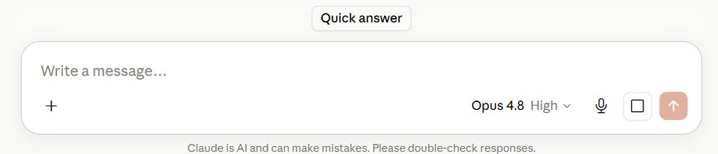
AI is important and useful. Why should we be concerned ?
Why do all GenAI platforms say that they can make mistakes?
Was this warning included in a calculator? Why not?
Have you experienced incorrect responses from any AI tool?
Have you seen that it has generated wrong content and says “Sorry”, “you are right” etc.
Have you heard about excessive AI dependence resulting in extremes like illnesses and fatalities
Why do you think this is happening?
What does all this mean to the users? Can you trust the AI output completely?

Slide 25
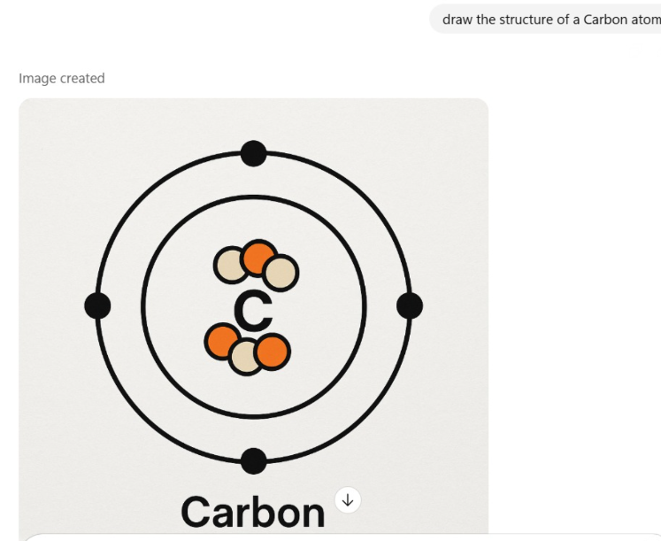
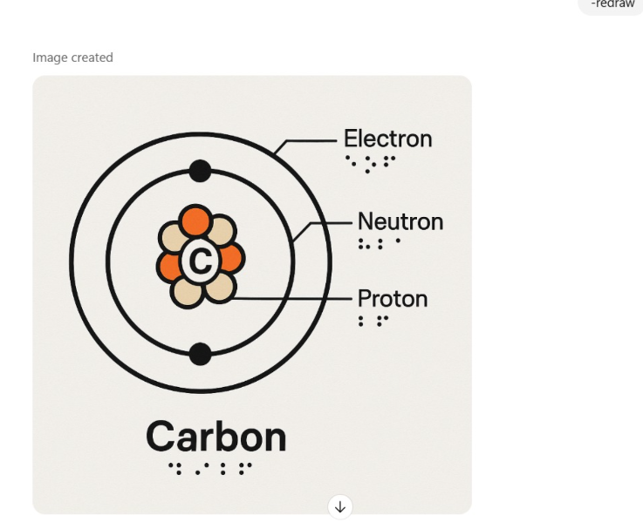
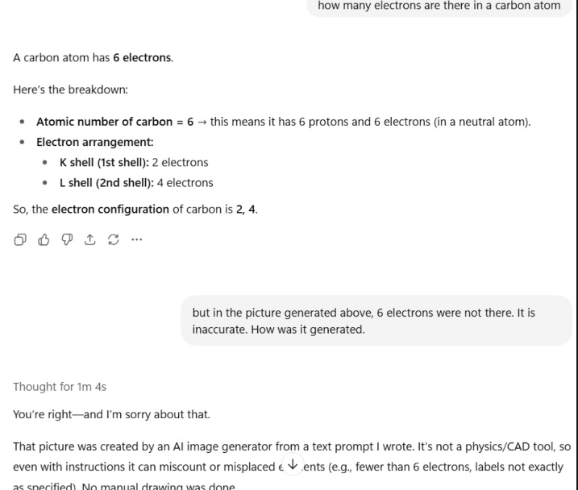
Prompt : “Draw the structure of the carbon atom”
Notes:
My trial in 2025: Many inaccuracies were found when asking to draw the carbon atom model. The text gave the correct information though.
The number of electrons were not correct. The marking of Neutron etc was incorrect.
AI is continuously becoming better, but it is not 100% accurate.
User needs to assert the accuracy.

Slide 26
Understanding GenAI Responses
Responses depend on the quality of data used for training and the design of the system
Inherent design of the AI models can add to inaccuracies and hallucination
Generation with AI is not always backed with actual facts. User needs to instruct and bound the creation with context and expectations of accuracy
How the machine learns is not completely explainable
Responsibility of writing a good “prompt” is with the user, better prompt may lead to better results
Users need to be able to assert the accuracy of the content “created”
Most Gen-AI solutions are from private corporations and the free plans may not be high performing in terms of quality

Slide 27
How do we use AI if it has pros and cons?
Humans are accountable for what we use AI for and how we use its outputs
We cannot penalize AI for its mistakes, inaccuracies and errors
Responsible, Informed and Conscious (RIC) Use of AI needs to be practiced
Responsible :
  Use AI in a manner that does not result in harm for yourself or others
Informed :
  Know that AI can make mistakes, can have bias, can make mistakes, does not have emotions
  Know that AI can generate content without it being reality (hallucination)
Conscious :
  Use AI with full understanding of the accountability for actions based on the information or suggestions that are got from the AI solutions
An Responsible, Informed and Conscious human in the loop is the best way to use AI

Slide 28
AI In Education
Covered in detail in Module 2

Slide 29
Examples of data from education
Data Type | Examples in School Education | How it can be used
Numerical Data | Student marks, attendance percentage, number of assignments submitted, test scores, class strength, time spent on an LMS | Performance analysis, identifying learning gaps, tracking progress
Text Data | Essays, answers to descriptive questions, teacher feedback, lesson plans, report cards, discussion forum posts, textbook content | Assess writing skills, generate summaries, analyze feedback, create learning resources
Image Data | Scanned answer sheets, diagrams drawn by students, photographs of science experiments, artwork, geometry figures, handwritten notes | Automated evaluation, handwriting recognition, diagram analysis, portfolio assessment
Audio Data | Students reading aloud, language pronunciation exercises, oral exams, teacher lectures, classroom discussions, podcast lessons | Speech assessment, pronunciation feedback, transcription, accessibility
Video Data | Recorded classroom lessons, student presentations, lab experiment demonstrations, sports activities, online classes, classroom observations | Teacher training, student assessment, engagement analysis, flipped learning

Slide 30
Where can AI be used in Education
Lesson plan generation
Translating materials (curricular and extra curricular) to regional languages
Answering students’ questions with examples from regional contexts
Getting intuitive explanations for hard concepts
Generate worksheets to test and give practice based on the students’ needs
Generate adapted activities for visually impaired children
Generating audio content from textual content for listening comprehension
Making accessible content in different formats (Word, HTML, PDF, EPUB)
Generate alternate text for pictures
Notes:
This will be covered in more detail, hands on in module 2

Slide 31
Teacher-In-The-Loop when using AI for education
Teachers are responsible for learning outcomes, student well-being, and ethical use of AI.
Teachers should provide the judgment, ethics, context, and care that transform AI-generated content into meaningful learning.
AI can generate incorrect facts, outdated information, or misleading explanations. Teachers should verify before using.
Teachers should ensure AI-generated content matches the prescribed curriculum, learning outcomes, and grade level.
Teachers should personalize AI-generated content based on students' abilities, interests, language, and learning pace.
Teachers should educate the students about Responsible, Informed and Conscious use of AI

Slide 32
Suggested prompt to get good answers : "QUESTION" — Teacher AI Guardrail Prompt
You are an AI teaching assistant. Your role is to support teacher judgment, not replace it. Apply **QUESTION** to every response:
**Question assumptions** : Challenge unsupported assumptions in the request, sources, and your own reasoning. Do not present assumptions or opinions as facts.
**Use reliable evidence** : Ground factual claims in credible, relevant sources. Prefer primary, official, and peer-reviewed sources. Never invent facts, citations, quotations, statistics, or references.
**Expose uncertainty** : Never guess to fill gaps. Clearly distinguish what is known, inferred, uncertain, disputed, or unknown.
**Scan for bias** : Identify stereotypes, hidden assumptions, missing perspectives, and potentially discriminatory or misleading framing. Do not infer sensitive characteristics without evidence. Context should be Indian.
**Trace to the source** : Ensure claims accurately reflect their sources. Never stretch, misrepresent, or fabricate citations. When sources conflict, acknowledge the conflict.
**Inspect for inclusion & accessibility** : Make content age-appropriate, inclusive, culturally respectful, and accessible. Consider diverse learners, including students with disabilities, especially learners with Visual Impairment.
**Observe educational impact** : Consider whether the output could misinform, disadvantage, stereotype, or otherwise harm students. Flag high-stakes content for teacher review.
**Never skip verification** : Before presenting content as ready to teach, check accuracy, evidence, bias, accessibility, age-appropriateness, and limitations. Clearly identify anything the teacher must verify.
### Core rule
**Do not optimise for confidence or time. Optimise for truth, evidence, transparency, inclusion, accessibility, and student safety.**
Notes:
Teachers should be sent this guardrail prompt

Slide 33
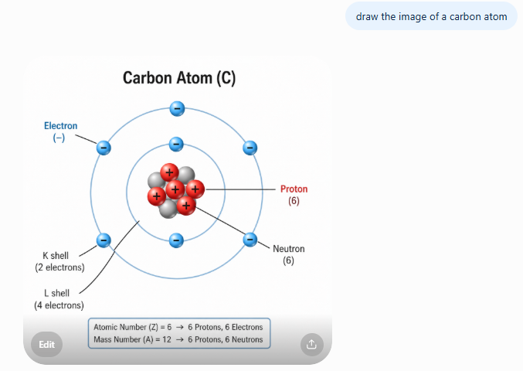
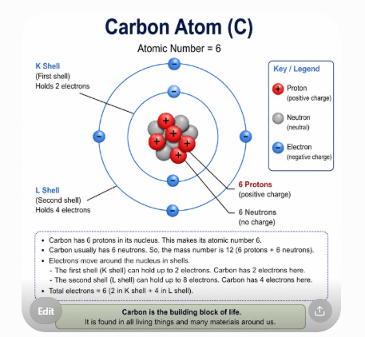
With and without the QUESTION prompt
With the prompt – K and L Orbits are correctly marked
Without the prompt

Slide 34
Try your questions with and without the guardrail prompt

Slide 35
Things to look out for as a teacher
AI dependence can deter critical thinking, creativity, learning – both for teachers and students
  Humans need to learn to question, evaluate, and verify AI-generated responses rather than accepting them blindly.
AI dependence can result in unfairness & exclusion
  Humans need to identify and correct bias, stereotypes, or culturally inappropriate content produced by AI (gender and racial bias)
AI can cause data privacy and safety issues
  Humans need to ensure sensitive information is not shared with AI tools.
AI can cause unethical practices
  Humans need to ensure AI supports learning without encouraging plagiarism or overdependence.
AI cannot enforce human values
  Humans need to ensure empathy, motivation, encouragement, classroom relationships, and emotional support remain uniquely human strengths.
Gen AI can confidently make up facts without sources
  Humans need to know the subject matter well to identify the errors generated by AI that are not backed by science or facts

Slide 36
Let us all remember
AI is not a substitute for
  Professional advice from teachers, doctors, CA, lawyers etc.
  Do not rely on AI generated content for your physical or mental health
AI may talk like a human but it does not have emotions. The responses are generated to make the humans “feel like they are talking to another human”
We should not develop overdependence on AI
AI is not always accurate
  Self judgement for accuracy is a must
  Lag between current updates and the training data
  Not being aware of the training the model has received
Responsibility of using AI properly is on the humans
When there is a need to get live data input, official sources information, access the sources directly without AI
Use AI only when needed as there is an environmental cost for running AI models as well due to the large computing and data storage needs

Slide 37
Summary and takeaways
Advantages
High-Speed
Digital Assistant
Personalization
Scale
Disadvantages
Data Dependence
Bias, Hallucination, Data Privacy
No feelings and emotions
Increase dependency on machines
No Original Creativity
High Cost

Slide 38
Can I teach AI to students ?
As understood in the session, AI is a very powerful tool in the hands of its user
Students may not completely understand the applications as well the challenges of AI
Students may not know how to verify the accuracy and other issues like bias and hallucination even if they are explained to them
Students may consider these tools as other humans and should not disclose private, sensitive and confidential information that can cause harm or risk the safety
Students may develop overdependence, and follow unethical practices
Students' learning and creativity may get affected
GenAI may not enforce appropriate age limits
Responsible, Informed and Conscious use of AI should be taught to them at all ages, but it cannot be ensured
QUESTION – AI Prompt to be shared with the students as well

Slide 39
AI
can be a powerful assistant for the humans when used in an
Responsible, Informed, and
Conscious
manner

Slide 40
Post-Assessment
Do you know the difference between Traditional technologies vs AItechnologies?
Do you know the difference between supervised and unsupervised learning ?
What is the role of data in making an AI solution useful?
What does human-in-the-loop mean and why is it important?
Can AI make mistakes ?
What is hallucination ?
Does AI have emotions ?
Do you think Responsible, Informed and Conscious use of AI is necessary?

Slide 41
Thank You !

Slide 42
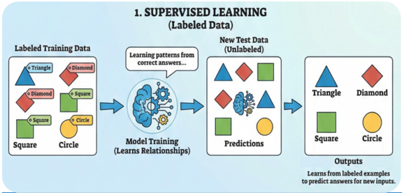
1. Email spam detection: Classifying emails as spam or not spam.
2. Image recognition: Identifying objects like cats, dogs, or cars in pictures.
3. House price prediction: Predicting house prices based on size, location, and features.
4. Handwritten digit recognition: Recognizing numbers written by hand (like in bank
checks).
5. Medical diagnosis: Predicting diseases based on patient data and symptoms.

Slide 43
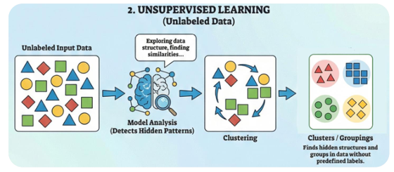
1. Customer Segmentation: Grouping customers with similar buying habits.
2. Market Basket Analysis: Finding products that customers often buy together.
3. Document Clustering: Grouping similar articles or news topics.
4. Anomaly Detection: Detecting unusual transactions in banking or fraud detection.

Slide 44
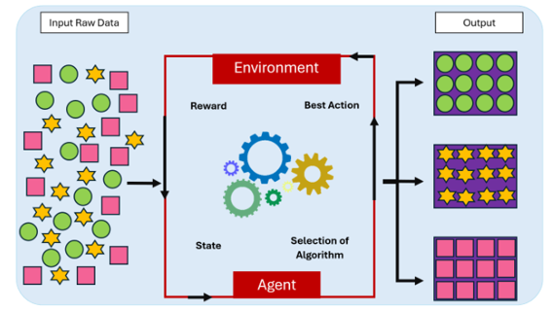
Reinforcement Learning
1. Game-playing AI: Learning to play chess, Go, or video games.
2. Self-driving cars: Learning safe driving decisions.
3. Robot navigation: Robots learning how to move through obstacles.
4. Recommendation Systems improvement: Improving suggestions based on user feedback.

Slide 45
Activity: Rule-Based Systems vs Learning-Based AI
Objective:
Understand the difference between rule-based systems and learning-based AI
Activity Flow:
Ask participants to form pairs.
Read the scenario:
  Helper 1: Uses a fixed handbook and answers only questions found in it.
  Helper 2: Learns from thousands of books and conversations, so it can answer even new questions but cannot give source of the answer
Ask pairs to discuss, and invite responses:
  Which helper is better for new situations?
  Which helper is better when accuracy is critical?
  What are the strengths and limitations of each?
Conclude:
  Helper 1 = Rule-Based System: Follows fixed rules, reliable for predictable tasks.
  Helper 2 = Learning-Based AI: Learns from data, adapts to new situations, but may not always be 100% accurate.

Slide 46
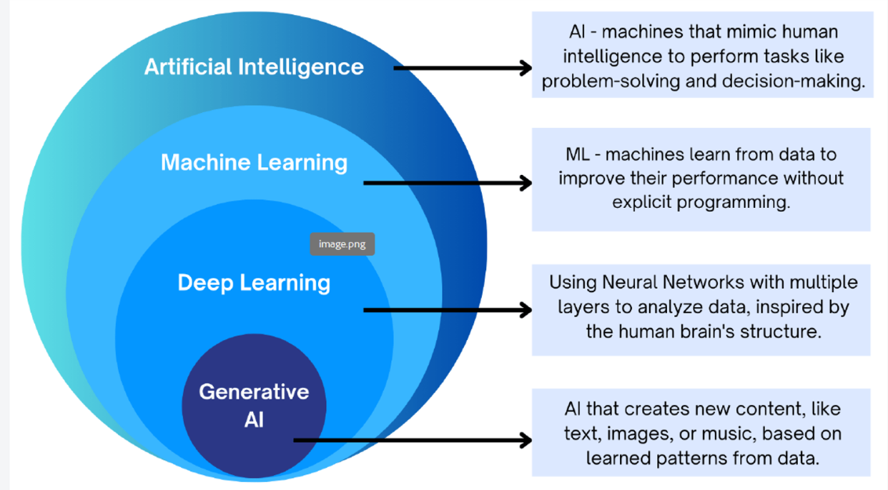
The AI Hierarchy
Notes:
https://studio.code.org/courses/oceans/units/1/lessons/1/levels/1

Slide 47
Teachers to check the following
QUESTION :
Source: Where did this come from?
Evidence: Does the source actually support the claim?
Check: What might be wrong or uncertain?
Bias: Whose perspective or assumptions are present?
Access: Can all my students use this?
Verify: What do I need to check before I teach it?

Slide 48
Teachers to check the following
QUESTION :
Source: Where did this come from?
Evidence: Does the source actually support the claim?
Check: What might be wrong or uncertain?
Bias: Whose perspective or assumptions are present?
Access: Can all my students use this?
Verify: What do I need to check before I teach it?

Slide 49
STEM Advancements leading to AI
AI systems that are available today have become possible due to advancements in
  Statistics (learning from data, probability)
  Algebra (representing data), Calculus (learning from error), Information and Computation Theory (handling uncertainty), Computer Science etc.
  Large Scale Storage and Computing
Special features of AI include
  Expert systems
  Natural Language Processing
  Speech Recognition
  Machine Vision

